Slide 1

KeyInsights
Intelligent Keyword Extraction & NLP Analysis
Sourav E23CSEU1865
Prakhar E23CSEU1863
Shreyansh E23CSEU1869
Under the guidance of Ms. Dipika Jain, Assistant Professor
Tech Stack: Python, Streamlit, Transformers, spaCy, BERTopic

Slide 2

Objectives & Key features
Automate deep text understanding with minimal setup.
Extracts keywords
summaries
Identify key terms and insights from text
Generate concise summaries automatically
sentiments & NER
Visualization
Perform sentiment & entity analysis
Visualize data as word clouds, graphs, and trends
Handles TXT, PDF, DOCX inputs
Generates interactive visualizations & PDF reports

Slide 3
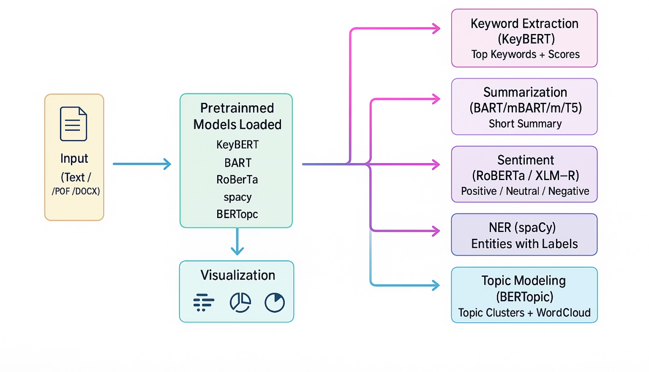
KeyInsights : NLP working Pipeline

Slide 4




System Architecture
Frontend:
Streamlit + Custom CSS
Backend:
python , Pretrained NLP Models
Visualization:
Plotly, PyVis, Matplotlib
Report Export:
ReportLab (PDF/DOCX.)

Slide 5
Core Components
Module
Function
Library
KeyBERT
Keyword Extraction
SentenceTransformers
BART / mBART / mT5
Summarization
Transformers
RoBERTa / XLM-RoBERTa
Sentiment Analysis
HuggingFace
spaCy
Named Entity Recognition
spaCy
BERTopic
Topic Modeling
BERTopic
NetworkX + PyVis
Knowledge Graph
NetworkX

Slide 6
Dataset & Training Source
We use pretrained models — already trained on massive public datasets.
Model
Dataset(s) Used
Domain
KeyBERT (MiniLM)
SNLI, MultiNLI, STS-B
Semantic Similarity
BART
CNN/DailyMail
News Summarization
mBART / mT5
CC100, XLSum
Multilingual
RoBERTa
TweetEval, SST-2
Sentiment
spaCy
OntoNotes 5.0
Entity Recognition
BERTopic
20News, BBC, Wikipedia
Topic Discovery

Slide 7

Validation & Metrics
Task
Metric
Accuracy/Score
Keyword Extraction
Spearman Corr.
0.83–0.86
Summarization
ROUGE-L
44–45
Sentiment
F1 / Accuracy
90–92%
NER
F1-score
85–90%
Topic Modeling
Coherence
0.55–0.70

Slide 8





Real-World Applications
Media & Publishing
Enterprise
Automated content tagging
Document classification, regulatory compliance tracking, and business intelligence extraction
Research
Customer Intelligence
Literature review automation, patent analysis, and knowledge graph construction
Feedback analysis, sentiment tracking, and emerging trend detection from support tickets

Slide 9


Future Work ?
Domain-specific fine-tuning
Real-time summarization API
Confidence scoring for outputs

Slide 10
References
Reimers & Gurevych (2019) – Sentence-BERT
Lewis et al. (2020) – BART: Seq2Seq Transformer
Barbieri et al. (2020) – TweetEval
Honnibal et al. (spaCy OntoNotes)
Grootendorst (2022) – BERTopic
Hasan et al. (2021) – XLSum Multilingual Dataset

Slide 11

Thank You!

